Slide 1
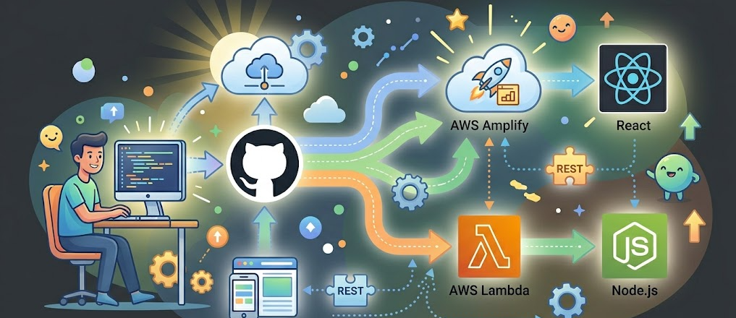
Software Deployment
Notes:
AI slop image created with Gemini 3 (https://gemini.google.com/share/1c1c3cba1c6a)

Slide 2
Motivating Scenario Online Store Circa 2005
It’s 2005, and your parents have a welding supply business
You create an online store for them (as a baby 😂)
What does your tech stack look like?

Slide 3
Motivating Scenario Online Store Circa 2005
Hook up Internet to your house
Put server in your garage
Use LAMP stack:
Linux
Apache web server (serves directories and files)
MySQL database (holds welding supply info)
All code written in Perl (e.g., for updating inventory)

Slide 4
Motivating Scenario Online Store Circa 2005
What’s nice about this?
What’s tough about this?
You can set up and run everything by yourself
Everything is relatively simple
You must set up and run everything by yourself!
How can you restart the server if you’re not home?
Who rebuilds the system when the hard drive dies?
What if a hacker gets in and hijacks your site?
How do you scale?
What if you needed more storage? bandwidth?

Slide 5
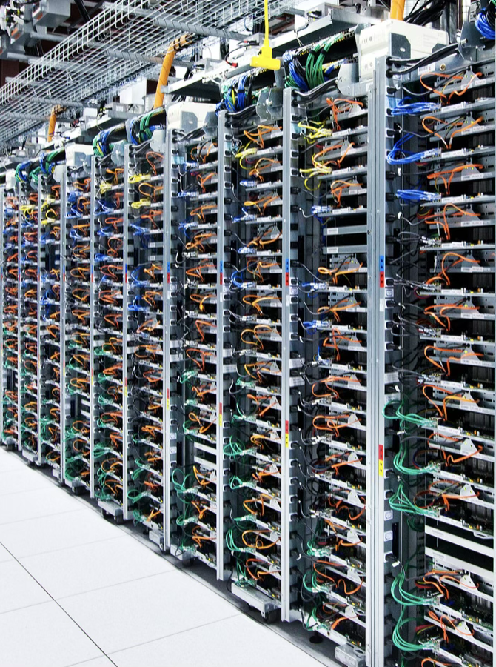
Enter Cloud Computing
Datacenters with thousands of computers
Someone else pays for hardware, cooling, networking infrastructure
Someone else maintains the physical infrastructure

Slide 6
Selling Cloud Services
Google offers Gmail
Software as a Service (SaaS)
They offer an application that does mail
You log in and use
Amazon offers EC2: Elastic Compute Cloud
Infrastructure as a Service (IaaS)
They offer virtual servers, networking, and storage
You do the OS and apps
Microsoft offers Azure
Platform as a Service (PaaS)
They offer an OS, scaling, deployment
You do apps

Slide 7
What’s Next?
Now: Sign up for H5-Deployment reflection question
For remainder of class: Work on deployment activity
Take notes for H5 reflection
Save AI chat transcripts
After class as homework: Work with team on P4-Testing

