Slide 1

Software Testing
Notes:
AI slop image created with Gemini 3 (https://gemini.google.com/share/99adad0fb1b6)

Slide 2
Software Testing: Motivating Example
Building web app for publishing news articles
Implemented feature for displaying articles
Create automated test to check (and re-check) that feature (still) works
  Prerequisite: Add testing framework to project

Slide 3
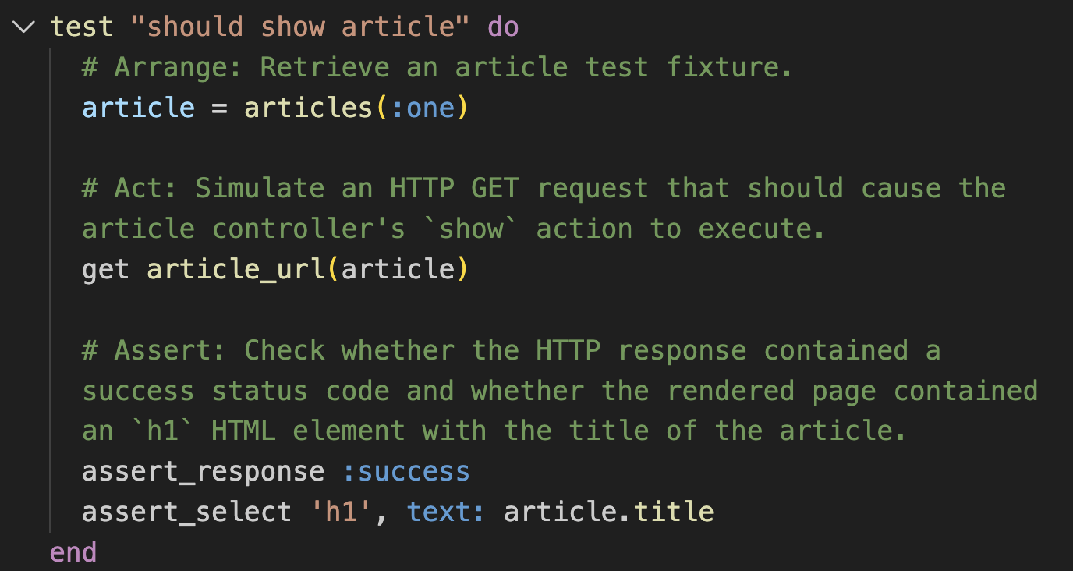
Example Test Case (Rails Minitest)
Focus: Test backend by simulating HTTP request

Slide 4
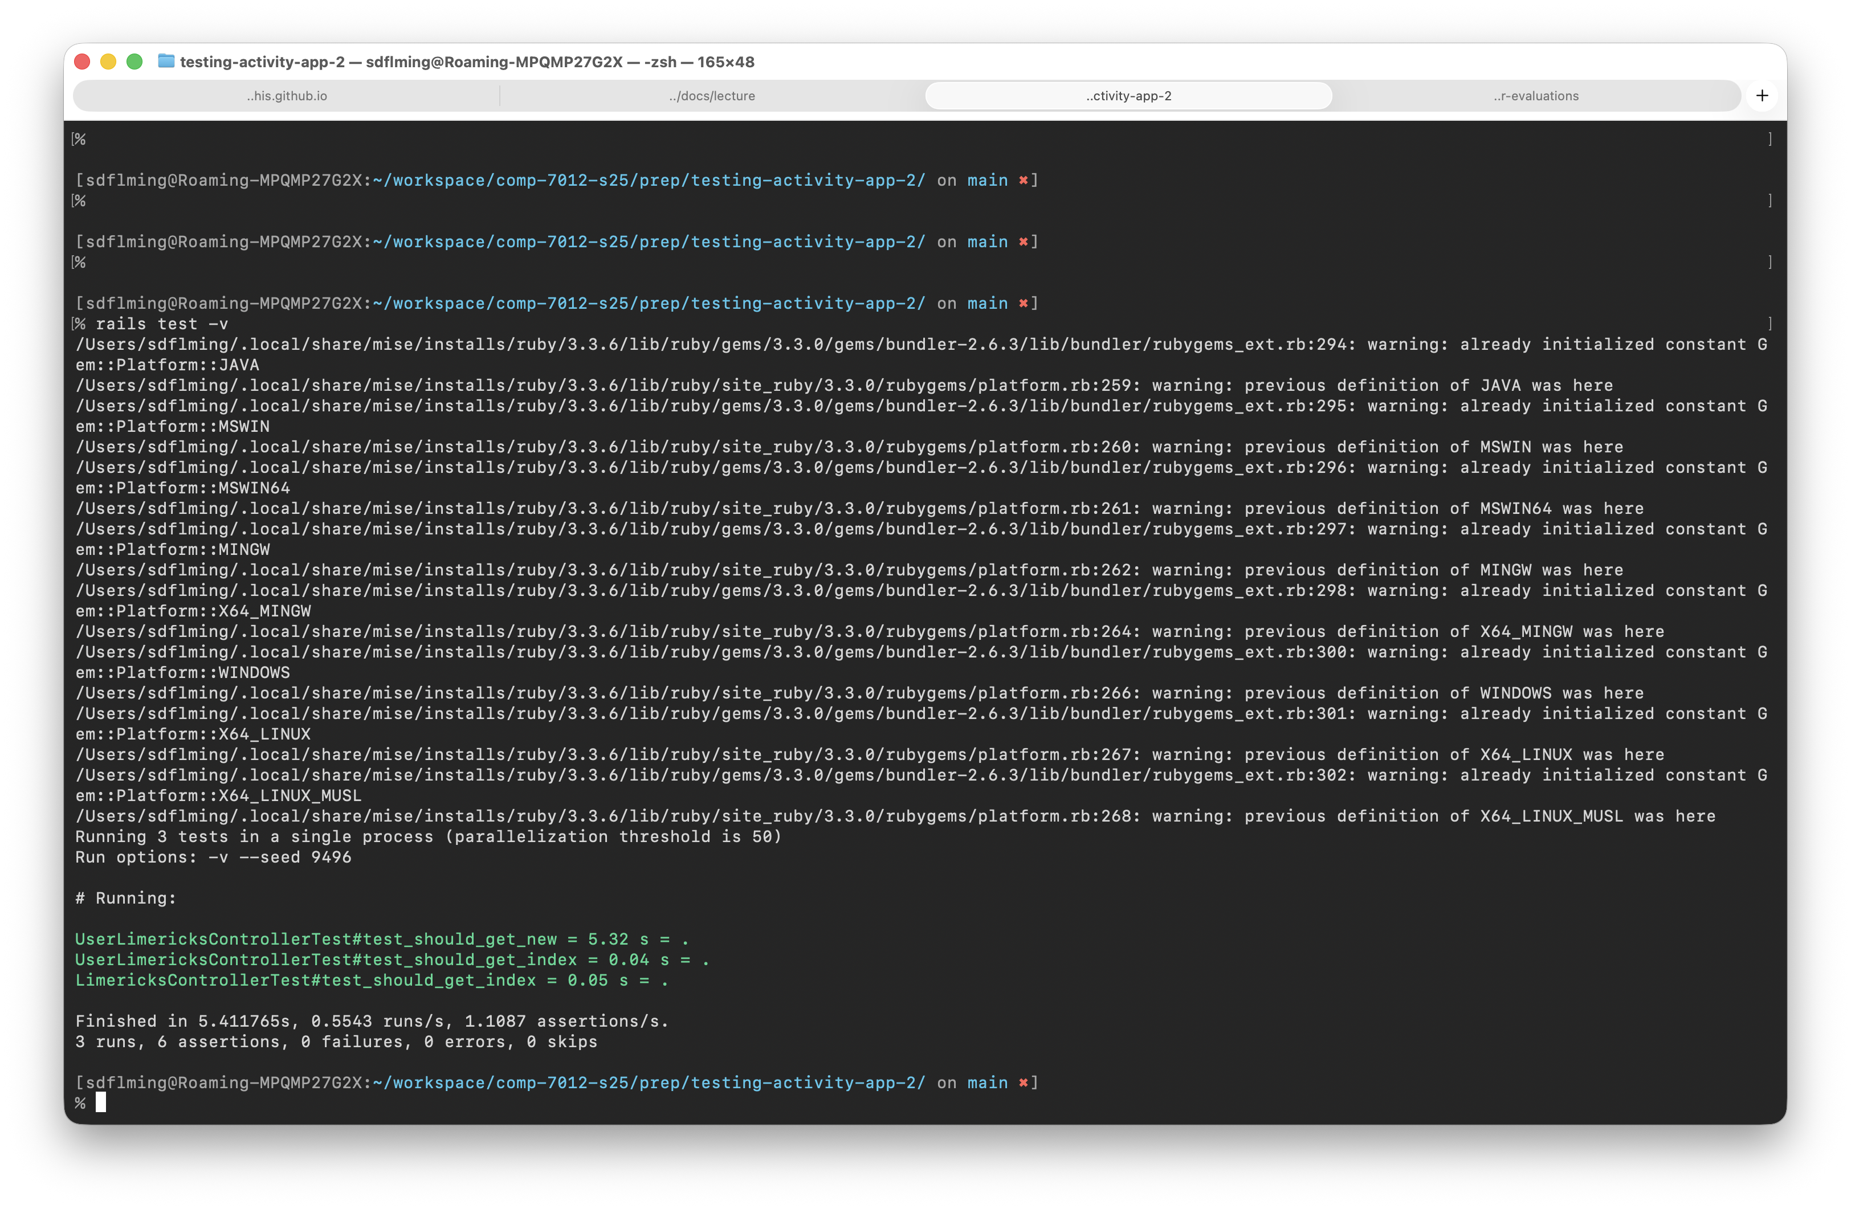
Execute Test Cases with Test Harness
Check if tests passed or failed
Or if system crashed (errors)

Slide 5
Software Testing [SWEBOKv4.0]
Software testing consists of the
dynamic validation that a
system under test (SUT) provides
expected behaviors on a
finite set of
test cases suitably
selected from the usually infinite execution domain.

Slide 6
Software Testing [SWEBOKv4.0]
Software testing consists of the
dynamic validation that a
system under test (SUT) provides
expected behaviors on a
finite set of
test cases suitably
selected from the usually infinite execution domain.
What subset of the system to test?
Unit testing
Integration testing
System testing

Slide 7
Software Testing [SWEBOKv4.0]
Software testing consists of the
dynamic validation that a
system under test (SUT) provides
expected behaviors on a
finite set of
test cases suitably
selected from the usually infinite execution domain.
Specification of…
Input
Expected output
Test suite is set of test cases

Slide 8
Software Testing [SWEBOKv4.0]
Software testing consists of the
dynamic validation that a
system under test (SUT) provides
expected behaviors on a
finite set of
test cases suitably
selected from the usually infinite execution domain.
Execute the SUT on a test case
Pass: If SUT produces expected output, test is passed
Fail: Else test is failed
Error: SUT may also crash

Slide 9
Software Testing [SWEBOKv4.0]
Software testing consists of the
dynamic validation that a
system under test (SUT) provides
expected behaviors on a
finite set of
test cases suitably
selected from the usually infinite execution domain.
Exhaustive testing is impracticle
What test cases to select?
Black-box testing
White-box testing
Regression testing

Slide 10
White-Box Testing Example
Focus: Assess statement coverage of test suite
Install code coverage analyzer (SimpleCov)
Run tests (analyzer collects data)
View coverage analysis results
Add/update tests to improve coverage

Slide 11
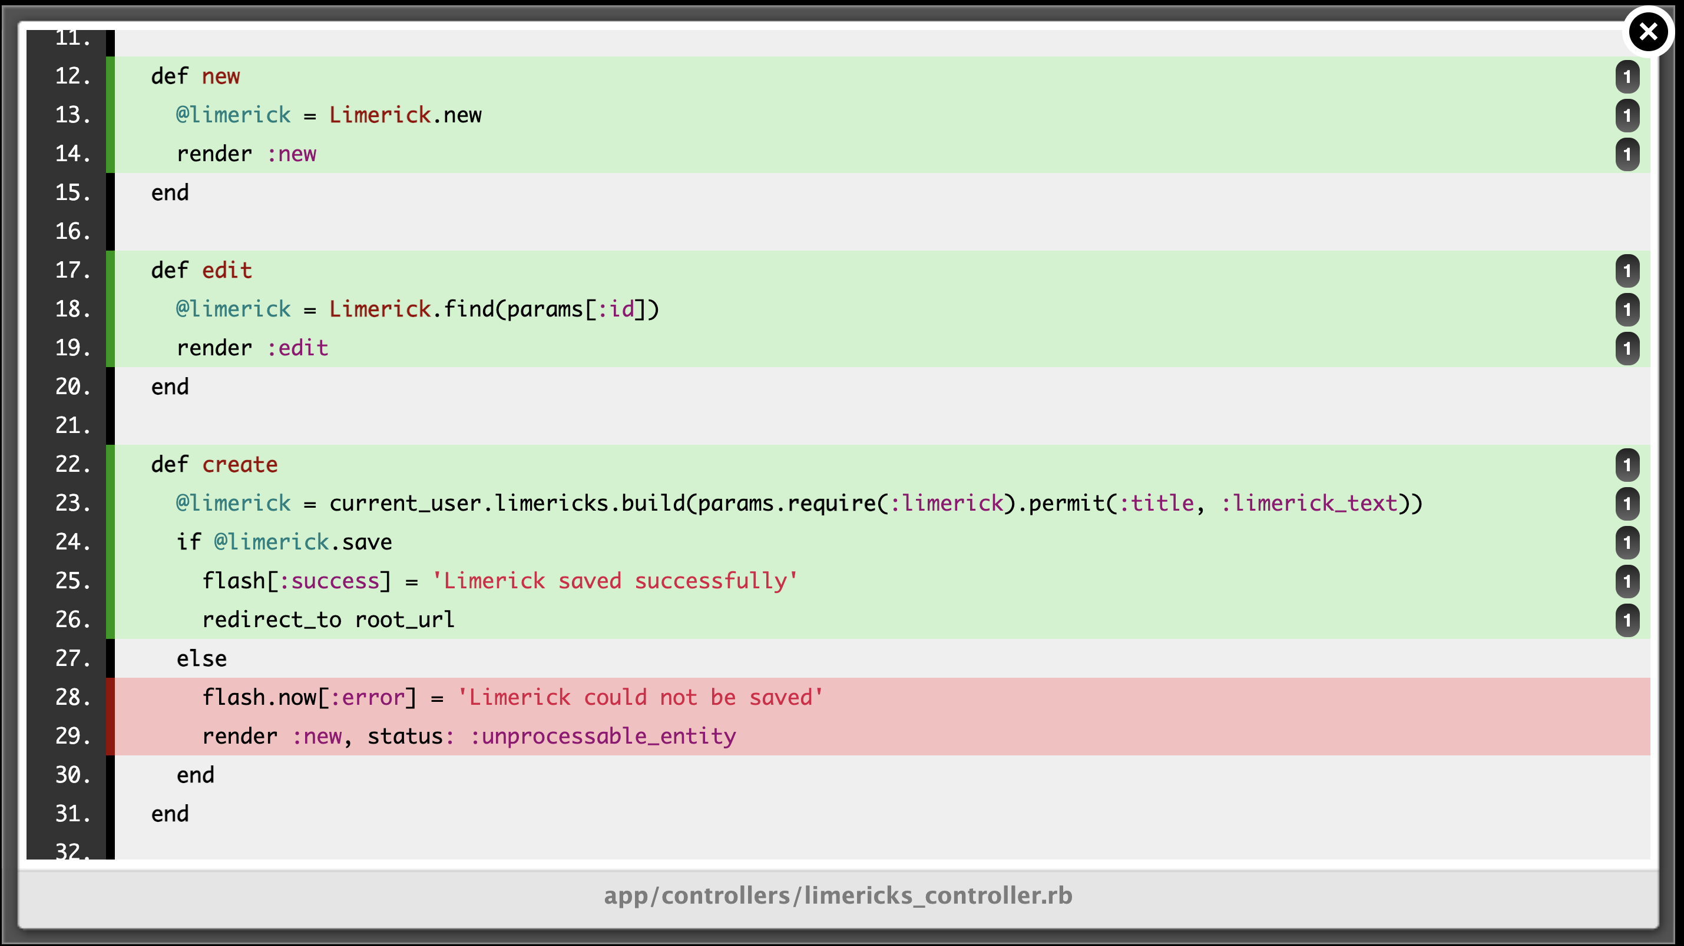
Example Statement Coverage Analysis

Slide 12
What’s Next?
Select H5 reflection question
  Keep question in mind as you do testing assignments/activities
Do the following activity
  Be prepared to show and tell in upcoming class

Slide 13
Activity
Collaborate with AI to Write Tests
Write different types of tests
  Unit, integration, system
  Prerequisite: Select and install testing framework
Run tests
Achieve coverage levels (e.g., statement coverage)
  Prerequisite: Select and install appropriate tools
Take small steps
  To ensure you understand
  To make reviewing tractable
Make the AI explain

