Slide 1

Frontend Development
Notes:
AI slop image created with Gemini 3 Fast (https://gemini.google.com/share/50eee5d6570d)

Slide 2
User Discovery High-level understanding of key features
↓
User Stories Detailed list of features
↓
UX Storyboards High-level understanding of key user interactions
↓
Wireframes Detailed understanding of user interface design
↓
Software Architecture High-level understanding of system design
↓
Frontend Development Implementation of user interface

Slide 3
Frontend Development Context:
Application Architecture
Frontend User Interface
Infrastructure
Tests
Application Core / Data

Slide 4
Where Do These Components Live?
Frontend User Interface
Infrastructure
Tests
Application Core / Data

Slide 5
Where Do These Components Live?
Frontend User Interface
Client
Infrastructure
Tests
Server
Application Core / Data
Frontend development focus: Client construction

Slide 6
Frontend Development Approach
Information Architecture
Navigation
Responsive Layout
Technology Stack
  HTML, CSS, client-side JS
  Web frameworks
Stub of Application Core/Data (i.e., Back End)
Let’s see an example…

Slide 7
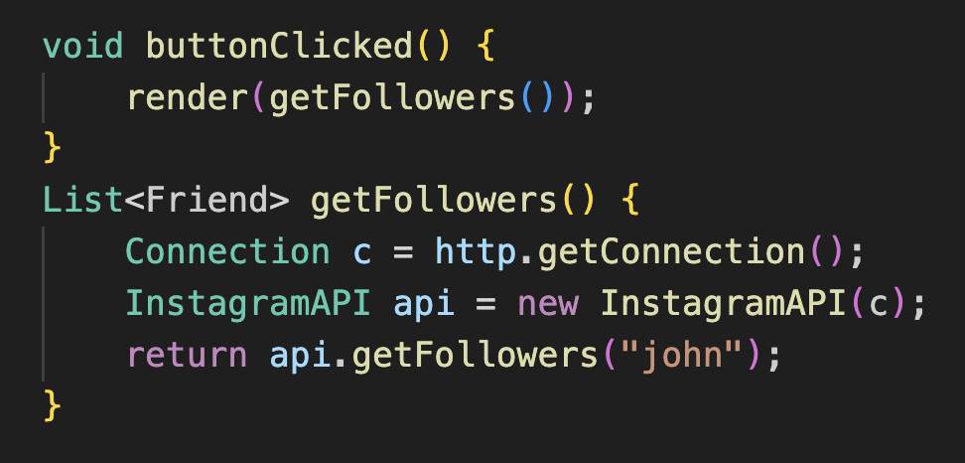
Scenario: Building app that lists Instagram followers

Slide 8
Uses Instagram API

Slide 9
Problem: Haven’t built Instagram yet

Slide 10
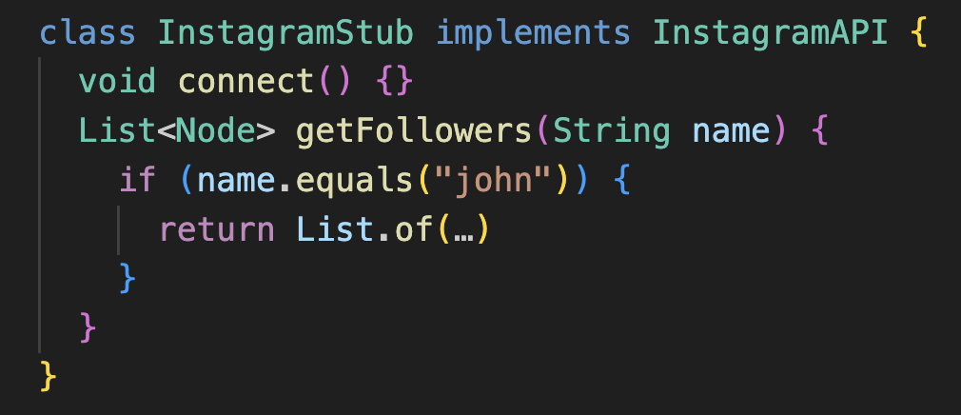
Solution: “Stub” InstagramAPI

Slide 11
Solution: “Stub” InstagramAPI
Stub:
Placeholder code used as temporary replacement for module, function, or remote service not yet developed or unavailable
Provide minimal, predetermined responses, allowing higher-level components to be tested and integrated without final implementation

Slide 12
Stub class implements InstagramAPI interface

Slide 13
Stub class has stub methods

Slide 14
connect stub does not actually connect to service

Slide 15
getFollowers stub merely returns static data

Slide 16
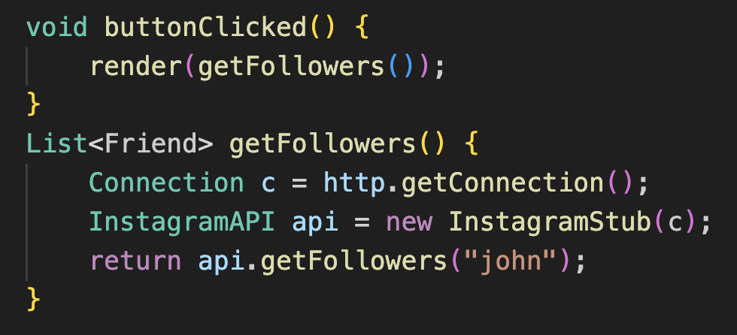
Use stub instead of InstagramAPI

Slide 17
Activity
Develop Project Frontend with AI
Pair program with full team
Create new repo in course GitHub organization for frontend
Give AI user stories, UX storyboards, wireframes, etc. as input
With AI help:
  Choose tech stack
  Learn UI architecture of chosen framework
Tell AI to stub backend

Slide 18
AI Prompt Template
You are a <role>.
Your goal is to <task>.
Instructions:
- Analyze <something> for <purpose>
- Identify specific issues and explain each.
- Suggest concrete changes or alternate approaches to address the issues
- The response should be formatted as a list of findings.
Analysis Focus: <purpose>
Code: <code>

Slide 19
AI Prompt Template Example
You are a frontend developer.
Your goal is to add event handlers for common user interface tasks in this frontend code.
Instructions:
- Analyze the existing frontend code for UI elements that should respond to user input but have no event handlers.
- Identify specific issues and explain each.
- Suggest concrete changes or alternate approaches to address the issues.
- The response should be formatted as a list of findings.
Analysis Focus: Find UI elements that lack sufficient UI event handlers.
Code: The frontend code in the project’s `src/` directory.

Slide 20
What’s Next?
Now: Sign up for H3 reflection question
For remainder of class:
Work with team on frontend development activity
  Take notes for H3 reflection
  Save AI chat transcripts for upcoming P2
After class as homework:
Work with team on P1

