Slide 1
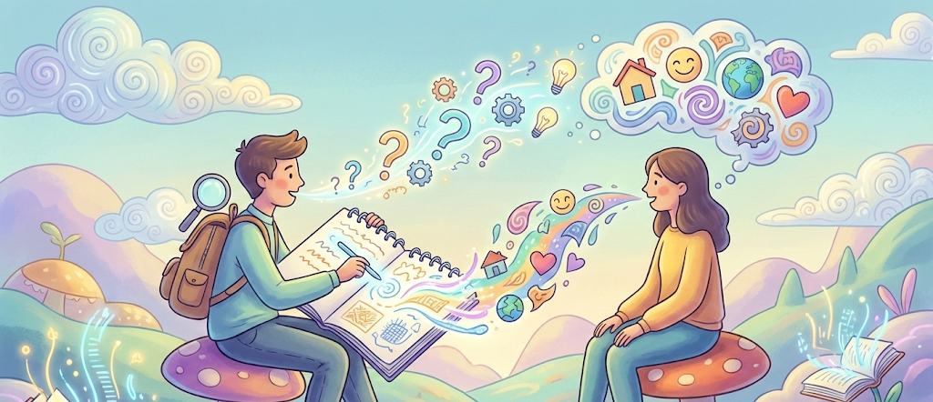
User Discovery
Notes:
AI slop image made with Gemini 3 Pro (https://gemini.google.com/share/fb815204232a)

Slide 2
What’s Next?
Using AI tools for software requirements
Beginning team project
H2 reflection essay
A3 user discovery activity

Slide 3
Activity Meet Your Project Team
The Project: Replicate entire software stack for popular tech startup for rest of course

Slide 4
Activity Sign Up for a Project
Instagram/Tiktok
Reddit
AI bots have to talk to one another to generate content
Uber/Lyft
Must simulate many, many concurrent users
X/Twitter/Bluesky/Mastadon
Use federation to post into real social media channels
Canva
Figma
Desktop Email client
Pick a real one to copy: Thunderbird, Outlook, Apple Mail, Proton Mail
Trello/Asana/Jira
AI bots have to create a project with user stories and work items
Slack/Discord
AI bots have to talk to one another to generate content
Zoom
Google Docs
Cursor.AI
Each team must pick their own startup from the list. No duplicates.

Slide 5
Using LLMs for Customer Discovery
Can we use LLMs that pretend to be customers?
Persona alignment covers various aspects of how a human customer would respond to questions: is the customer collaborative or combative?
Are the customer’s responses to questions clear and concise, or are they vague and incomplete, requiring follow-up questions?
Inspired by research: https://arxiv.org/html/2503.07800v2

