Slide 1

Vibe Coding Brownfield Projects
Notes:
AI slop image made with Gemini 3 Pro (https://gemini.google.com/share/989c26ecacce)

Slide 2
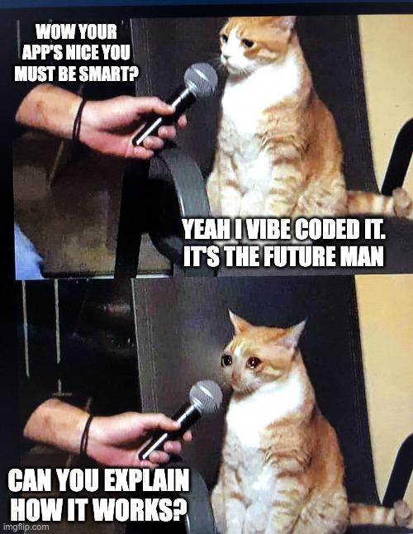
Source: ProgrammerHumor.io (2026) https://programmerhumor.io/programming-memes/can-you-explain-how-it-works-9f3w

Slide 3
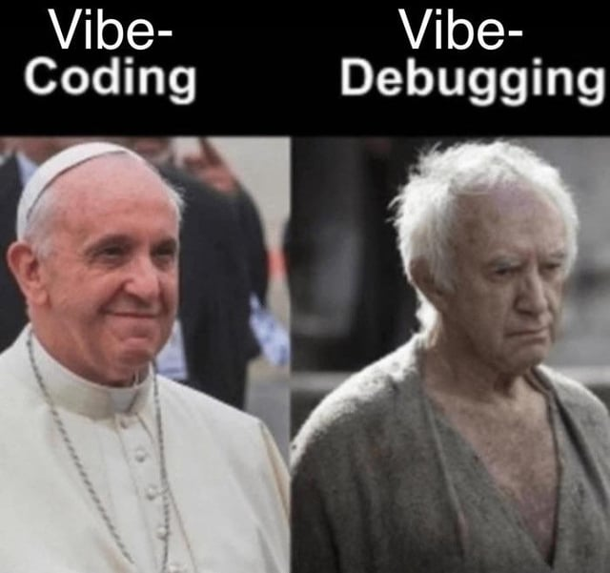
Source: My Vibe Coding Journey (2025) https://www.reddit.com/r/vibecoding/comments/1mge229/my_vibe_coding_journey/

Slide 4
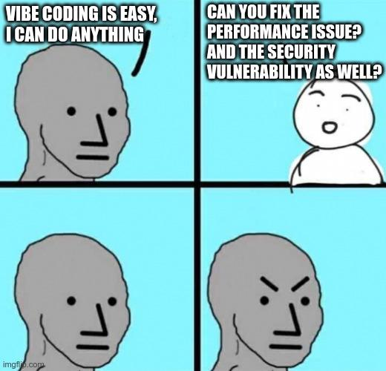
Source: ProgrammerHumor.io (2026) https://programmerhumor.io/programming-memes/when-vibes-meet-technical-requirements-7q30

Slide 5
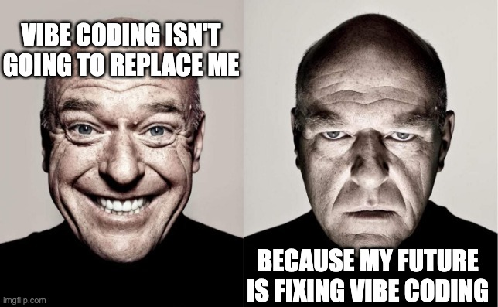
Source: ProgrammerHumor.io (2025) https://programmerhumor.io/ai-memes/vibe-coding-wont-replace-me-v5td

Slide 6
Remember Vibe Coding? Well…
Two uses of term have become common:
“Pure” Vibe Coding
Strict aherence to Karpathy’s original conception
Human never even looks at the code
Considered best for rapid prototyping
Known weaknesses: code quality, security, debugging
Responsible AI-Assisted Development
AI acts as collaborator or “pair programmer”
AI viewed as “junior developer” who can type 10,000 words per minute
Human acts as “AI conductor”, guides AI to write code
Human rigorously reviews, comprehends, and tests code
Human takes full responsibility for code
⇦ Today’s Focus
Source: What Is Vibe Coding? (2025) https://cloud.google.com/discover/what-is-vibe-coding

Slide 7
Greenfield vs Brownfield Projects
Greenfield: Build from scratch
Like vibe coding activity from last class
Brownfield: Build upon existing codebase
Historically a challenge for pure vibe coding
This week’s activity! 😁

Slide 8
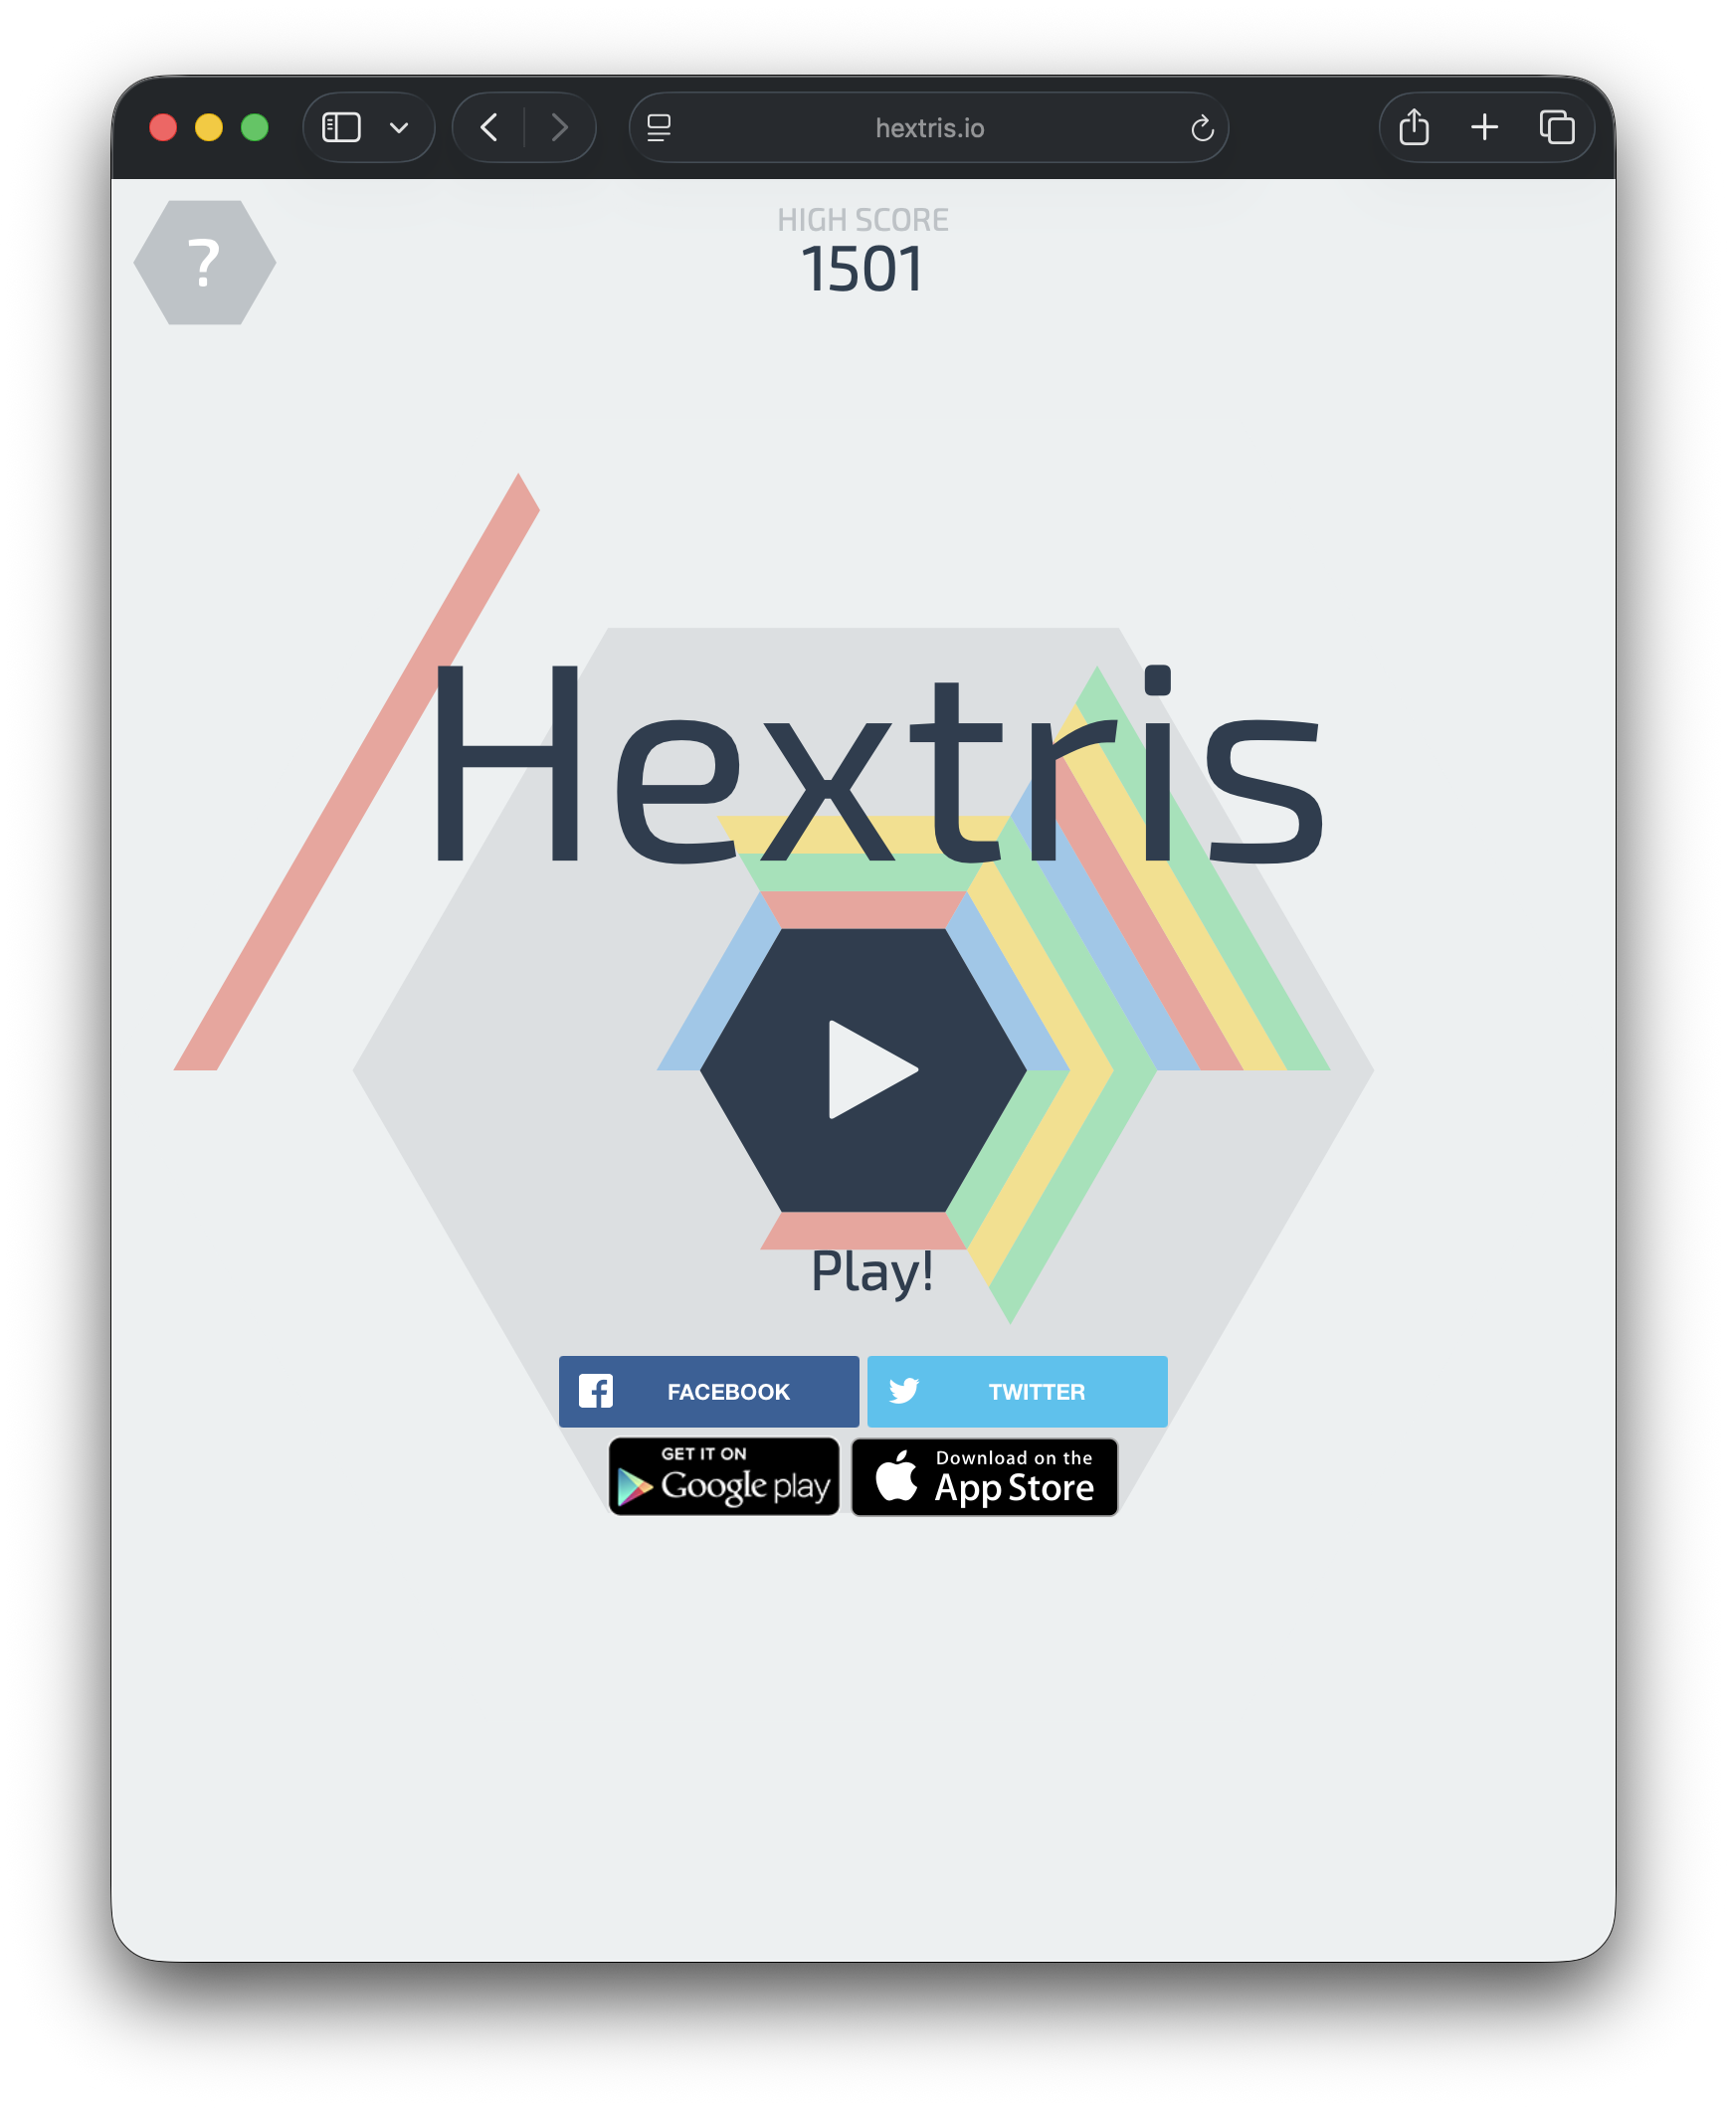
Shall We Play a Game?
Hextris
https://hextris.io

Slide 9
Activity Vibe Coding New Features for an Existing Project
Use VS Code + GitHub Copilot to vibe code
Work individually
But feel free to talk or ask questions
Rely on AI as much as possible
Don’t write any code yourself – let the AI do it!
AI can help you set up your dev environment too!
Try to understand the code this time
As in responsible AI-assisted development
AI can assist with code comprehension too!

Slide 10
Activity Task 1: Understand the Codebase
Hextris Codebase: https://github.com/Hextris/hextris
Use AI to understand how the code works
Ask it to generate documentation or diagrams
Explain it to another student near you using the docs
Is it good? Correct? Useful? Comprehensive?
Then swap and let them explain to you

Slide 11
Activity Task 2: Add a New Color Block
The game is too easy – another color will increase the difficulty!
Vibe code this new feature
Can you understand the code changes?
Test it – did it work correctly?

Slide 12
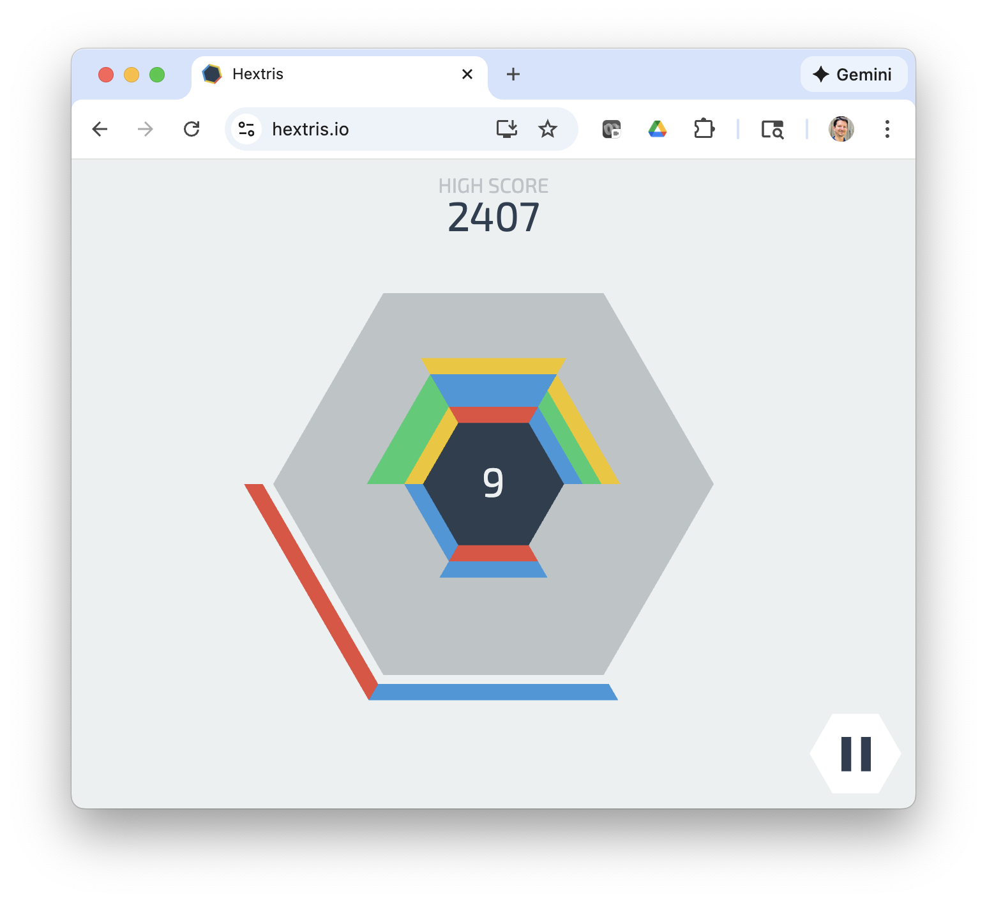
Activity Discussion: Hextris Tasks from Last Class
Task 1: Understand the Codebase
Task 2: Add a New Color Block
https://hextris.io/
https://github.com/Hextris/hextris

Slide 13
What’s Next?
Activity to be continued next class
Collect ideas for H1 essay

Slide 14
Activity Task 3: Students’ Choice!
Discuss with a partner what features we should add next
We will share ideas and vote

Slide 15
Activity Task 4: Add a “Ghost Block” That Adds to the Bottom of the Stack
Make a block that gets added to the bottom
It should look visually different
Do you understand how it works?
How did you test it? Any bugs? How confident are you?

Slide 16
Activity Task 5: Add Automated Tests
Brainstorm with AI how to add automated testing
Add unit tests to the project
How do you run the tests?
Are they passing or failing?
How many did you add? Where?

Slide 17
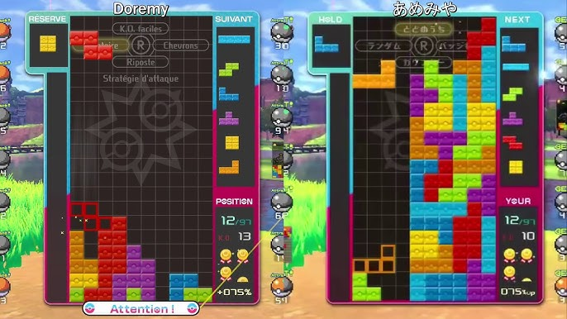
Activity Task 6: Add Local Multiplayer
Add local multiplayer that shows you and another player side by side while playing
Left player uses WASD, right player uses arrow keys
Continues until both players lose then show both scores

Slide 18
What’s Next?
Complete Homework H1 essay – due before next class!
Assignment: Form Project Teams – due in 1 week!

