Slide 1

Vibe Coding
Notes:
AI slop image made using Gemini 3 Pro (https://gemini.google.com/share/e04c54f33ec2)

Slide 2
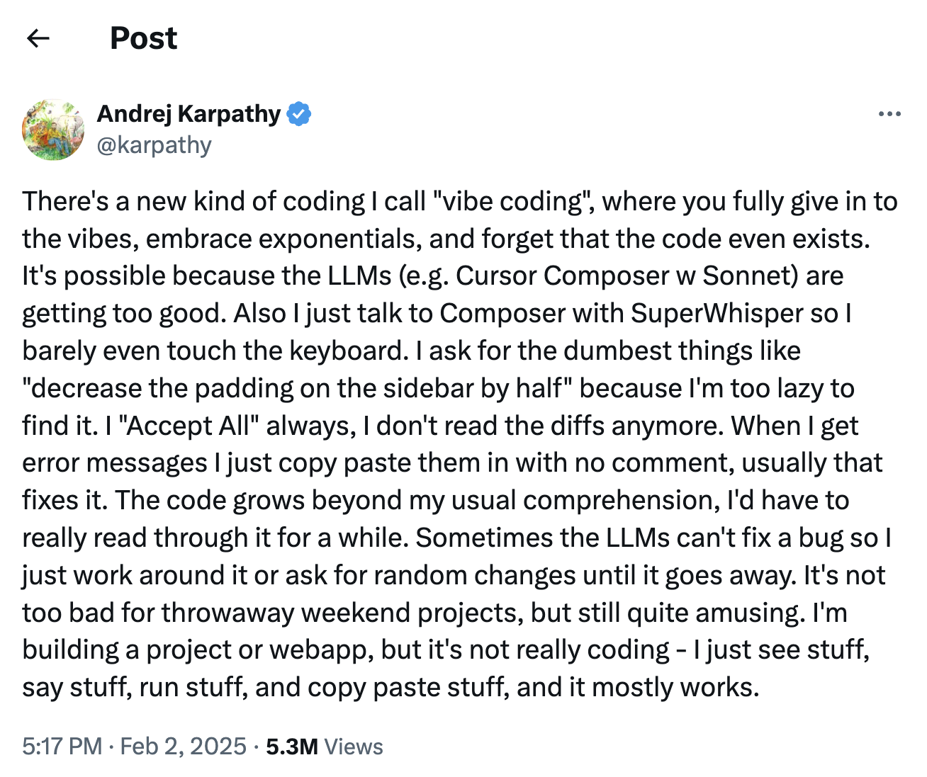
⇦ OpenAI Cofounder
Source: https://x.com/karpathy/status/1886192184808149383?lang=en
Notes:
About ”vibe coding”… Andrej Karpathy coined the term in Feb 2025, and it has since entering the popular vernacular.

Slide 3
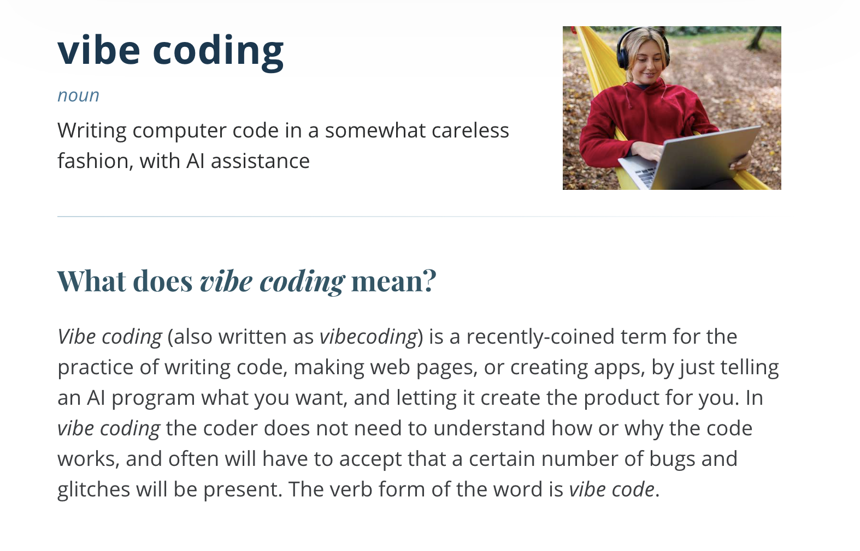
Source: Merriam-Webster Dictionary (2025) https://www.merriam-webster.com/slang/vibe-coding
Notes:
Vibe coding appears as a slang word in the Merriam-Webster Dictionary (2025).

Slide 4
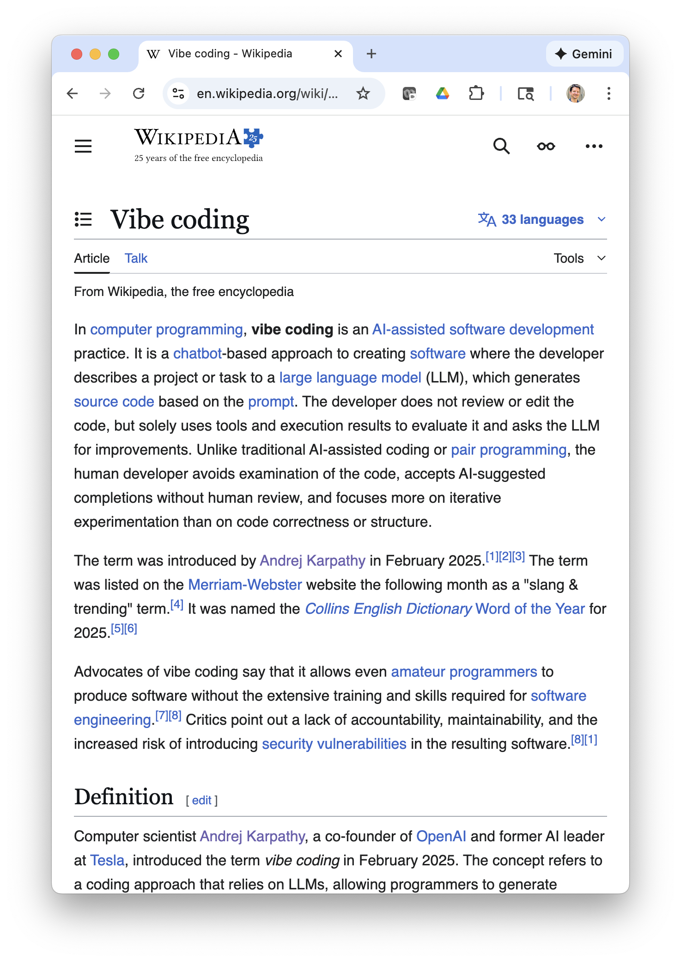
Vibe Coding
AI-assisted software development practice
AI chatbot-based approach to creating software
  Developer describes project or task
  AI generates code based on prompt
Developer does not review or edit code
  Uses tools and execution results to evaluate code
  Asks AI chatbot for improvements
Source: Wikipedia (2025) https://en.wikipedia.org/wiki/Vibe_coding
Notes:
Vibe coding has a wikipedia entry (2025).

Slide 5
What’s Next?
Vibe coding activities
  Today plus next 2 classes
But first, let me introduce Homework H1 reflection essay
  So, you can begin thinking about it

Slide 6
Activity
Vibe Code New Project
Use VS Code with GitHub Copilot
  Prerequisite: Complete set-up assignment in Canvas
Vibe code new project from scratch
Work individually
  But feel free to talk or ask questions
Rely on AI as much as possible
  Don’t write any code yourself… that is what the AI is for!
  Copilot can help you setup your dev environment too!

Slide 7
Activity
Project 1: Single-User Instagram
Next.js web app
Sqlite database
Deploy locally
Required features:
  Upload pictures
  Display feed of uploaded pictures, sorted chronologically
  App must have a logo you create (with AI!)

Slide 8
Activity
Project 2: Multi-User Instagram
Additional features:
  User registration and login
  Profile page with follow feature
  Feed only shows users you’re following
Landing page to show off app

Slide 9
What’s Next?
Homework H1: Vibe Coding Reflection Essay
  Sign up for question
  Gather ideas

