Slide 1
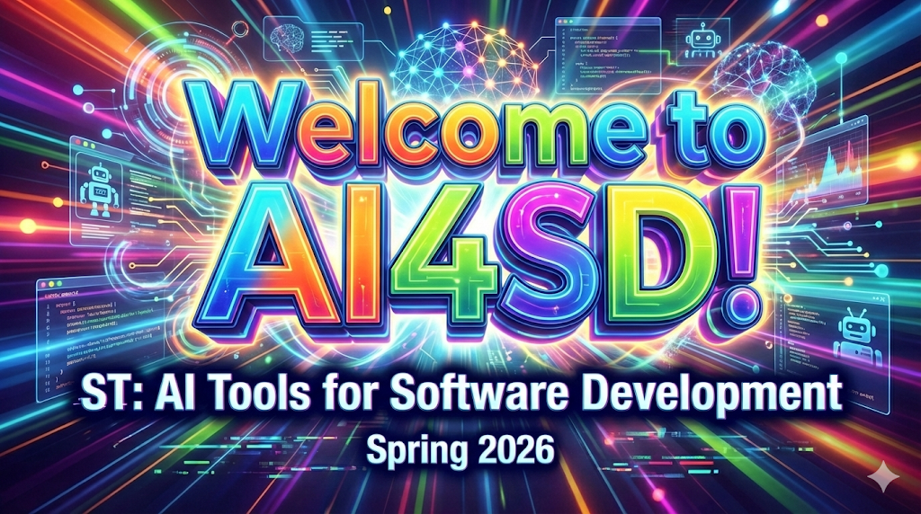
Notes:
AI slop image created with Gemini 3 Pro (https://gemini.google.com/share/d6e092dd3f13)

Slide 2
The Rapid Rise of GenAI Tools
Especially for Coding
June 2021 – GitHub Copilot Microsoft, OpenAI
  Early Codex; code completion only
Nov 2022 – Chat-GPT OpenAI
Mar 2023 – Bard Google
  Ancestor of Gemini
Mar 2023 – Claude Anthropic
Mar 2023 – Cursor Anysphere
Nov 2023 – Grok xAI
Dec 2023 – GitHub Copilot Chat Microsoft
Feb 2024 – Gemini Google
Early 2025 – Claude Code Anthropic
Mid 2025 – Codex OpenAI
Oct 2025 – Grok Code Fast 1 xAI
Oct 2025 – Gemini Code Assist Google

Slide 3
Excerpt from Sep 2025 CS-Ed Email List
We may be headed for a world where … programmers are expected to know how to use AI tools.
From my perch in the tech industry (Google), we are not "headed for" a world where programmers are expected to know how to use AI tools; we are in that world, and have been for months. My semi-annual performance review documents are required to include a section on use of AI tools, and we have an "AI learning week" every month or two -- and I'm not even in a division that works directly on AI (that's a different floor of the building). I suspect that most of the major tech companies have similar efforts underway.

Slide 4
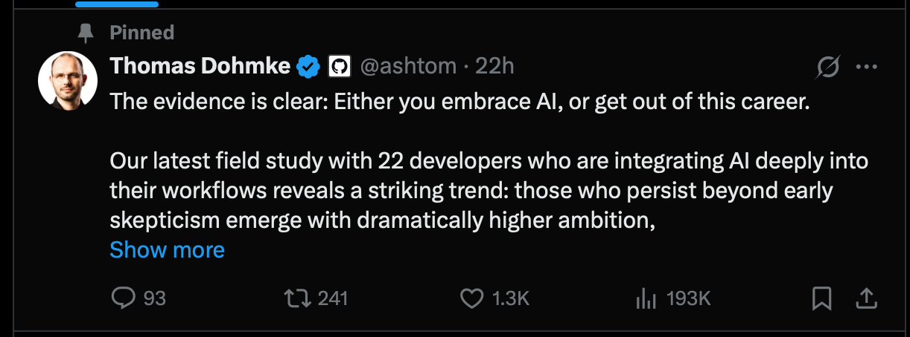
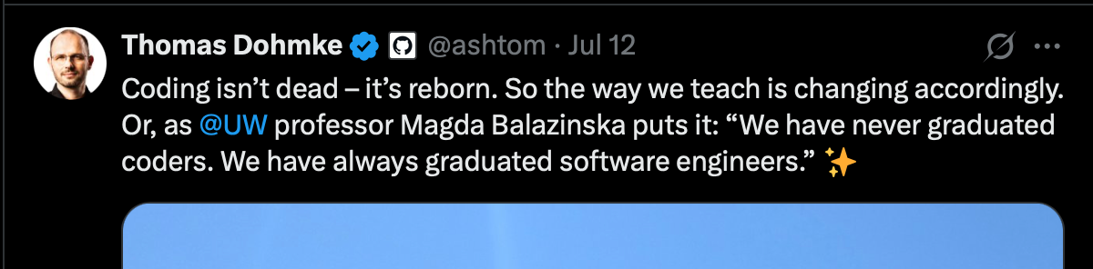
⇦ GitHub CEO (circa 2025)
Notes:
Thomas Dohmke, GitHub CEO (circa 2025).

Slide 5
Course Motivation
We want you to try different AI tools to see
  what you like and
  what they are good for
Teach you to be AI-enhanced software developer
  Job market for junior developers is down
  Could AI help you go from junior to senior?
This is a new world – we are learning this together!

Slide 6
Course Goal
Learn to Use AI tools across the
Software Development Life Cycle
Analysis &
Design
Requirements
Initial
Planning
Planning
Implementation
Deployment
Evaluation
Testing

Slide 7
Teaching Team
Dr Scott Fleming, Instructor
  CS Associate Professor and Department Chair
Mr Muminul Hossain, TA
  CS PhD Student
Computing Education Researchers!

Slide 8
Icebreaker!
Please share…
Your name
Your program and year of study
  E.g.: BS-CS junior, MS-CS year 2
Something interesting about GenAI tools
  An experience you’ve had…
  An opinion you have…
  A prediction you have…
  Advice you would give…
Something you hope to learn

Slide 9
What’s Next?
Tour de Course
Course Website
Canvas
Teams
Syllabus

